Slide 1
How to Score More Than 50 Points in Desert Sons SPG

Slide 2
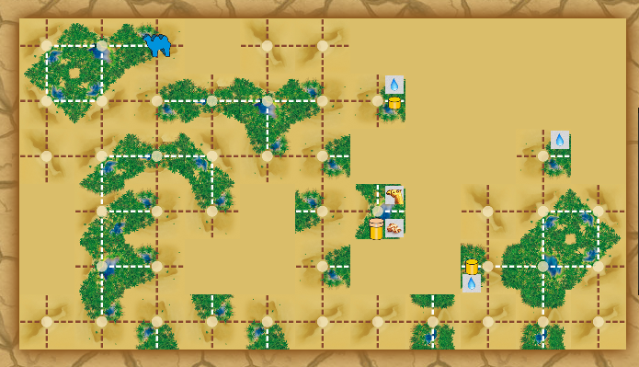
First Steps
1. Move your camel to here.
2. Draw a card from the stack and position it so it faces to either side.
3. End Turn w/o placing a stone. The Robber will place his highest stone on the spot
4. Repeat Steps 1-3 in these other locations.

Slide 3
First Oasis
I happened to have a 3-way piece in my selection to use. But you can also take the Robber’s 4-way piece to start. There is some luck involved here because I was able to finish the 1st oasis without any tricks. The robber only added his small stone so I left him . only a water.

Slide 4
Get to the next location.
I still had the robber’s 4-way piece to use, so I wanted to get over to a spot I could use it. The most obvious spot was here.
Now that I have no white lines blocking my path, I am free to move to my target location.
When I placed the corner piece (without placing a stone) the robber used is last stone as expected.
To get there, I moved the camel to the right and placed the robber’s corner piece.

Slide 5
Second Oasis
Now that my oasis is nearly complete, it is time to move the robber’s stone off of my land. I do this by laying down a distraction tile just above my oasis.
When I place the robber’s 4-way piece, he moves his highest piece and places it on the 4-way.
The 2nd oasis is now completed and the robber didn’t get any stones this time.

Slide 6
Third Oasis
From this point on, it was much the same as the second oasis. Once all stones are placed on areas you don’t need, the robber will only move the largest stone.
I decide to let the robber have a treasure here because he had the highest stone value and there was an extra camel that I did not need at the time.

Slide 7
Third Oasis
At this point, the robber had an end piece and a straight piece. They would fit perfect right where I was. So I let him have his small stone again.
Luckily, the robber did not get a chance to place his large stone.

Slide 8
Finishing the game
I have only a couple water left, but the robber has placed 2 stones on this last oasis. I have all 4 of mine placed. I also have a piece in my storage window. I spend water to buy the desert piece.
The desert piece opens a path to the other side of the board where I can lay down my last reserve tile.
Now, I am running out of water, so I stay where I am and make the most of it. I spend the extra water to place a tile that I know will fit. That seems to work better than praying.
With one more tile to place in order to finish my oasis and all 4 stones already placed, I click on a stone to remove it. The robber moves his large stone off of my oasis and I have one to place down.

Slide 9
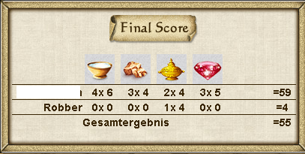
Final Results

